Slide 1



PROBLEM- Mobile Game for Alzheimer's Detection
A
PRESENTATION
ON
SYNAPSES
By- Tech Phantoms
Smart India Hackathon

Slide 2
OVERVIEW
Alzheimer’s disease is a type of dementia that causes problem with memory, thinking and behavior symptoms usually develop slowly and get worse over time, becoming severe enough to interfere with daily tasks.
Alzheimer has no current cure but treatment for symptoms are available and the research continues.

Slide 3



THE SOLUTION?
+
+
User’s Data
(Age Group, Gender etc.)
Game Statistics
Location

Slide 4
User Data
The game relies on the genetical heritage , Age group , Gender information of a person to properly gather information about Alzheimer as Alzheimer varies differentially across these groups

Slide 5
LOCATION
The game also relies on location as the chances of having Alzheimer varies from region to region as there are different conditions not only including food but stress levels and average life expectancy.

Slide 6
GAME STATISTICS
Now, Finally for the analysis the statistics measured by the games themselves is required as they measure the common areas of symptoms of Alzheimer

Slide 7
TechnologY STACK and tools used
Tech Stack
User’s phone
Tools
Unity Game Engine
SQLlite
Adobe Photoshop
Corel Draw
Visual Studio
OPENGL
UNITY
C #
SQL

Slide 8
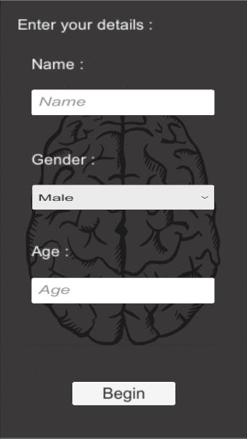
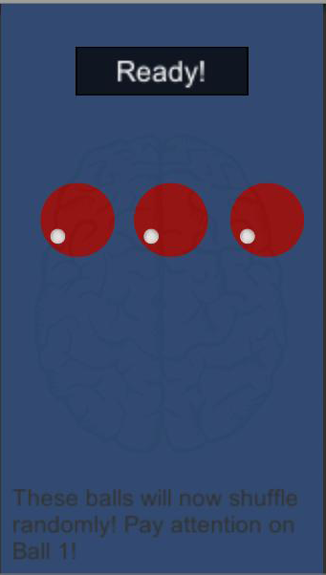
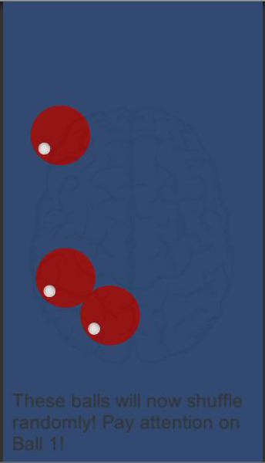

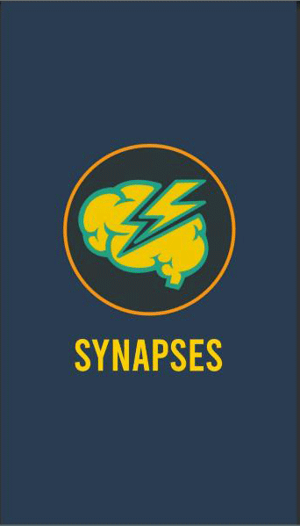
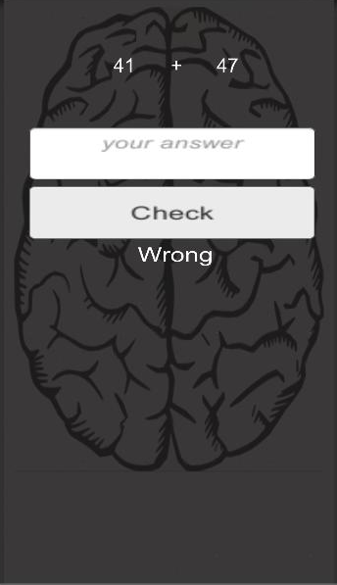
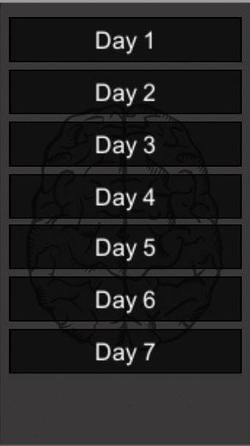
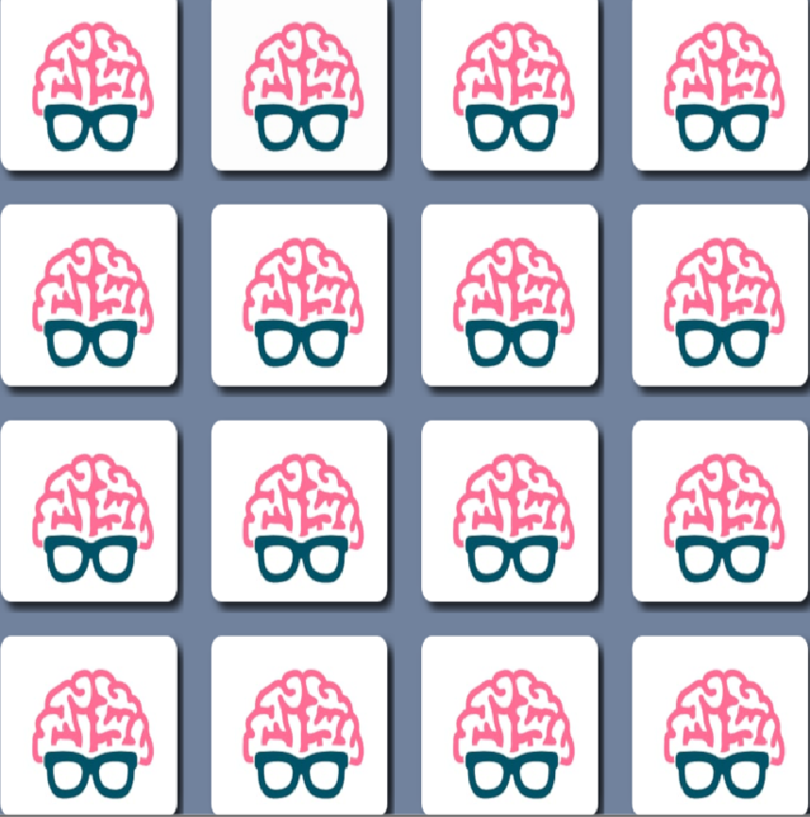
components
GAME
STAGE 1 MEMORY TEST
STAGE 2 CONCENTRATION
STAGE 3 LOGICAL REASONING
STORE DATA
ANALYSE DATA
SHOW RESULT

Slide 9

BOUNDARY OF SYSTEM
Use Application
Generate Data
Doctors/Hospitals/Researchers
Users
Stored Data
Analyzed Data
Data buyer
Customers/future patients

Slide 10
Conclusion
This game is particularly developed for Alzheimer patient for the early detection of the disease
This game will focus on concentration and memory of the user to measure the condition of the brain which can be compared with the results of an average brain and that of an Alzheimer affected brain.

